Slide 1
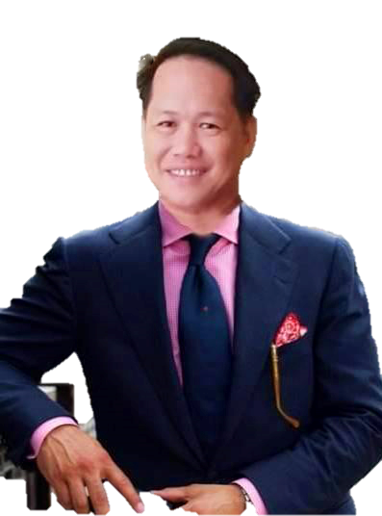
Zandro V. Ariston
Teacher – III

Slide 2
Objectives:
* Identify what is Google Classroom.
* Create Google Classroom.
* Add students in a Google Classroom.
* Set assignment/s to the students in a Google Classroom.

Slide 3
What is Google Classroom
It is a suite of online tools that allows teachers to set assignments, have work submitted by students, to mark, and to return graded papers.

Slide 4
What is Google Classroom
it has a wider use as teachers quickly implement paperless instruction. Classrooms works with Google Docs, Sheets, Slides, Sites, Earth, Calendar, and Gmail.

Slide 5
What does Google Classroom cost?
Google Classroom is free to use. All the apps that work with the service are already free-to-use Google tools, and Classroom simply conglomerates it all into a centralized place.

Slide 6
What does Google Classroom cost?
An education institution will need to sign-up for the service in order to add all its students and teachers. This is to make sure security is as tight as possible so no outsiders gain access to the information or students involved.

Slide 7
What does Google Classroom cost?
Google does not scan any of the data, nor does it use that for advertising. There are no advertisements within Google Classroom or the Google Workspace for Education platform at large.

Slide 8
Google Classroom assignments
A teacher is able to set assignments and then upload documents that explain what is required for completion, and also provide extra information and a place for students to actually work.

Slide 9
Google Classroom announcements
Teachers can make announcements that go out to the entire class. A message can also be sent out as an email so that. Or it can be sent to individuals who it applies to specifically

Slide 10
Lets Jump to Hands-on Activity
Zandro V. Ariston
Teacher – III

Slide 11
SPCES Virtual SLAC Matrix
Time | Activity | Resource
1:00 – 1:20 | Opening Program | Moderator: Mr. Ariston Statement of Purpose: Mrs. Gala Checking of Attendance: Mrs. Ritardo Hose Roles: Mrs. Capuno
1:20 – 1:40 | All about Google Classroom | Zandro V. Ariston Resource Speaker
1:40 - 2:40 | Exploring Google Classroom
2:40 – 3:00 | Open Forum
3:00 – 4:00 | Hands – on making and submission of outputs | All participants
Gala’s Group

